Slide 1

Exploring Local Authority Statistics
Presented by: Putluru Om Sai Nandan Reddy
Roll No: 56 | Section: K23GN
Course Code: INT375
Lovely Professional University
Under the Guidance of: Aashima

Slide 2

Introduction
Local authority statistics help evaluate services, population needs, and development.
Dataset: Local Authority Statistics - December 2024 Quarter.
Provides metrics across various regions in the UK.
Used for research, planning, and policy-making.
Analyzed using Python and its data libraries.

Slide 3

Objectives of the Project
Explore, clean, and analyze
Explore, clean, and analyze the dataset.
Perform
Perform statistical and visual analysis.
Identify
Identify trends and outliers in the data.
Understand
Understand correlations among variables.
Use
Use graphical representations for insights.

Slide 4

Tools and Libraries Used
Python Programming Language
pandas: Data handling and manipulation
numpy: Numerical operations
matplotlib: Basic visualizations
seaborn: Advanced and aesthetic plots
scipy: Z-score for statistical outlier detection

Slide 5
EDA (Exploratory Data Analysis)
EDA helps understand data before modeling.
Includes summarizing structure and contents.
Identifies patterns, missing values, and outliers.
Helps in selecting relevant models.

Slide 6

General Data Exploration
Used df.head(), df.info(), df.describe()
Identified rows, columns, data types.
Noticed missing values and data inconsistencies.
Found a mix of numeric and categorical data.

Slide 7
Data Cleaning and Preprocessing
Filled missing numeric values with mean.
Filled missing categorical values with mode.
Used .fillna() method for cleaning.
Cleaned data is consistent and analysis-ready.

Slide 8
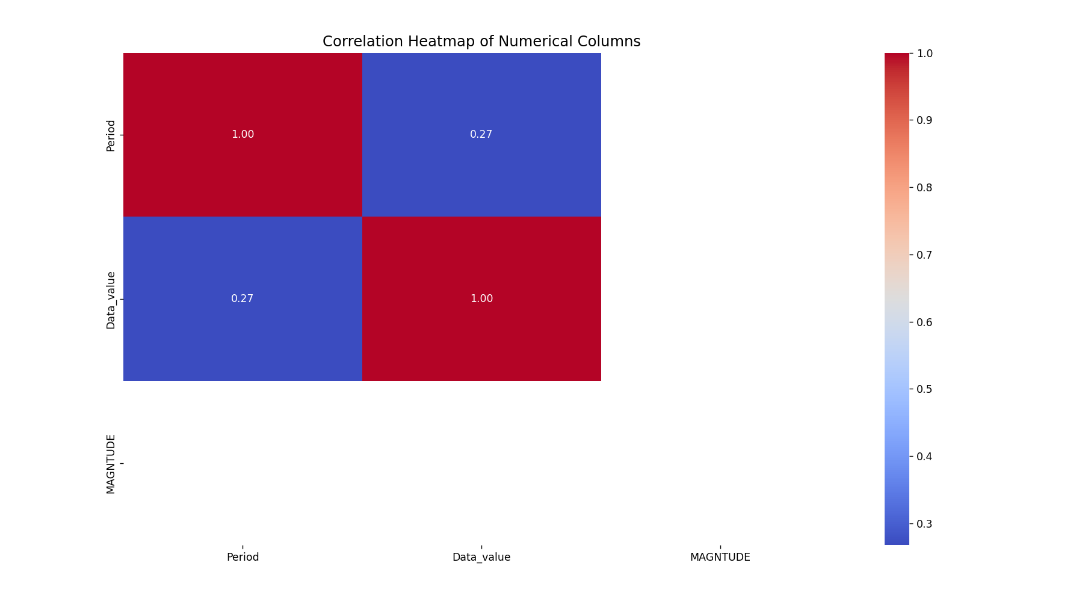
Correlation Analysis
Purpose: Find relationships between numerical features.
Used correlation matrix and heatmap.
Some features showed strong correlation.
Helpful for future feature selection.

Slide 9
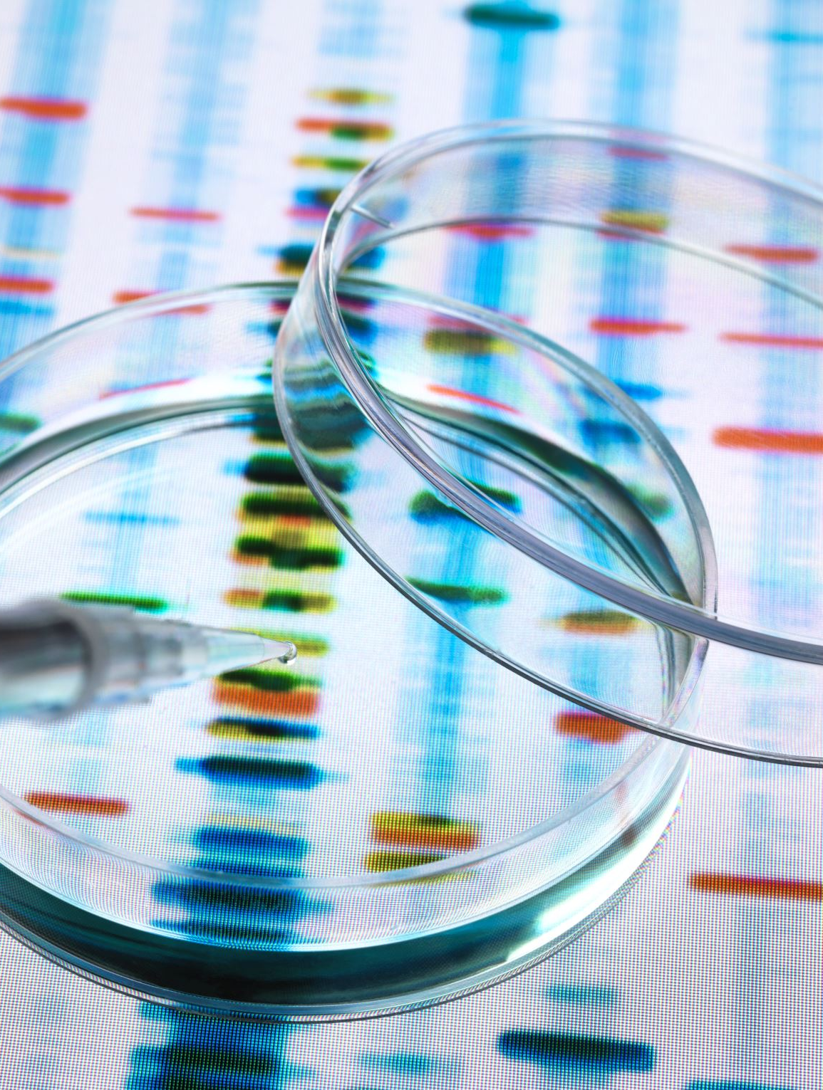
Outlier Detection
Used Z-score method to detect outliers.
Outliers are values far from the mean.
Used boxplots to visualize distributions.
Identified potential anomalies.

Slide 10
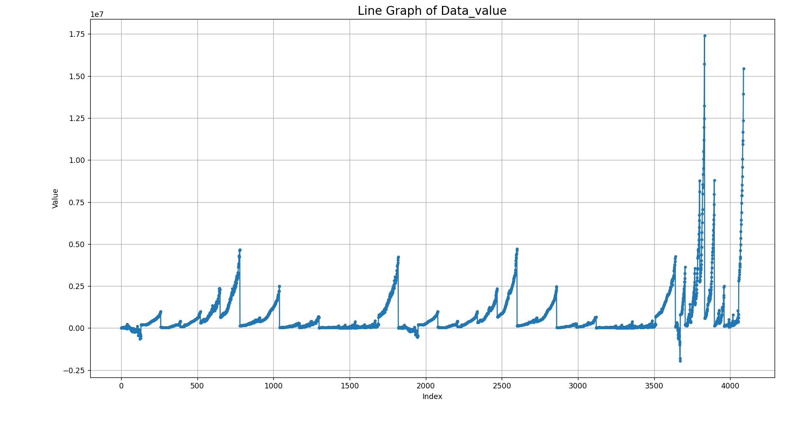
Trend Analysis
Plotted line graph of numerical features over index.
Observed value fluctuations over time.
Helped identify trends and seasonal changes.
Useful for time-based analysis.

Slide 11

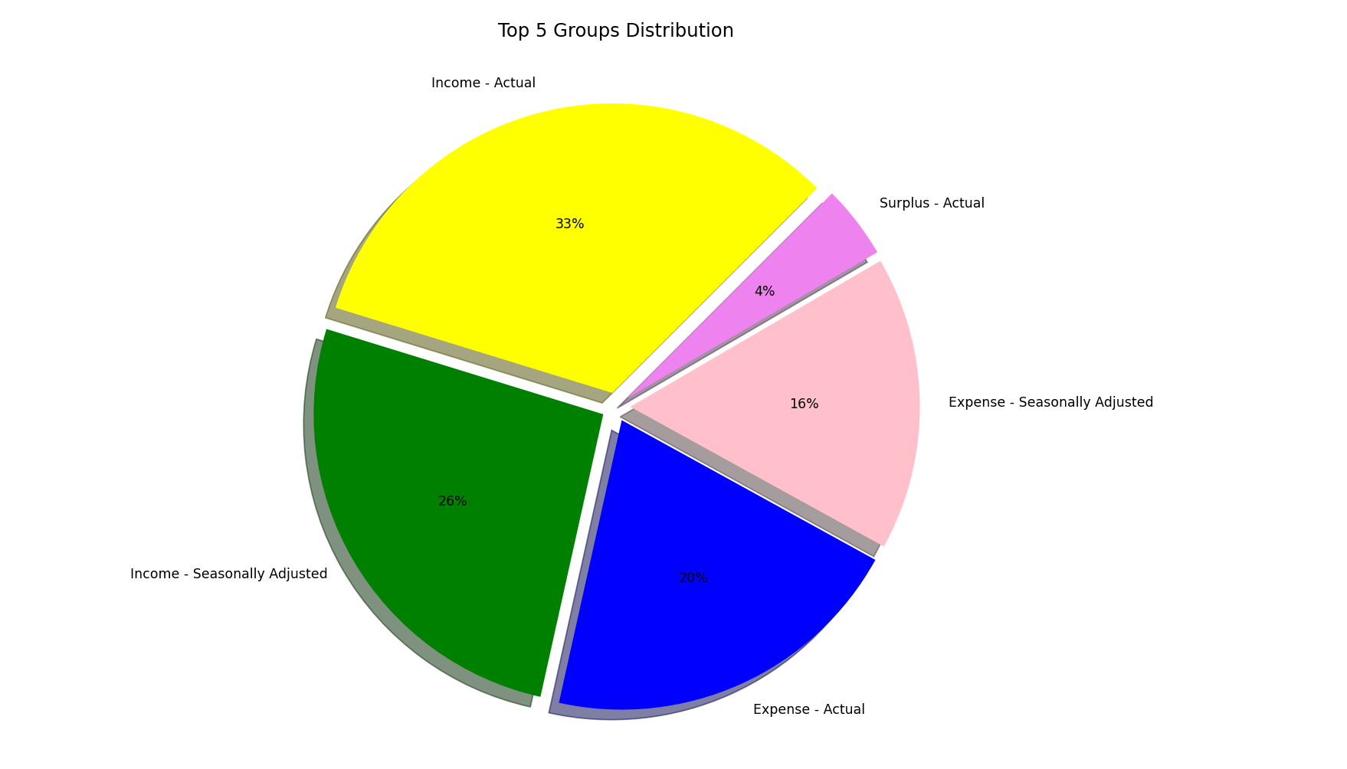
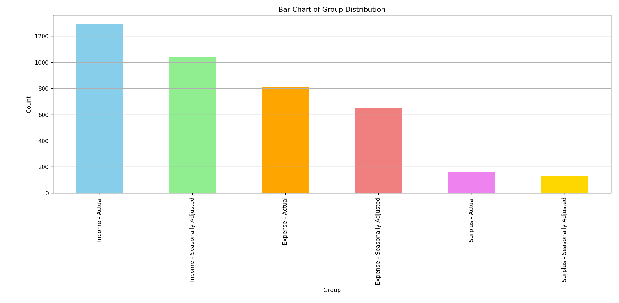
Categorical Analysis - Pie Chart and Bar Graph
Analyzed the "Group" column.
Used pie chart to show top 5 categories.
Found dominant groups in the dataset.
Used bar chart for "Group" distribution.
Showed frequency of each group visually.
Bar graphs give clear comparative insights.

Slide 12
Scatter and Pair Plots
Scatter plot: Visualized Period vs. Data_value.
Pair plot: Showed relationships between multiple variables.
Some plots showed linear patterns.
Useful for identifying multi-variable trends.

Slide 13
Conclusion
EDA revealed insights into structure and relationships.
Cleaned and visualized data for better understanding.
Outliers and trends were effectively identified.
Strengthened Python and data visualization skills.

Slide 14

Future Scope
Apply
Apply machine learning models on cleaned data.
Perform
Perform time series forecasting.
Build
Build interactive dashboards (e.g., Plotly, Tableau).
Merge
Merge with geographical/demographic datasets.

Slide 15
References
UK Government Data Portal
Python Official Documentation
Stack Overflow, Data Science Stack Exchange
Python for Data Analysis by Wes McKinney

Slide 16







